Slide 1
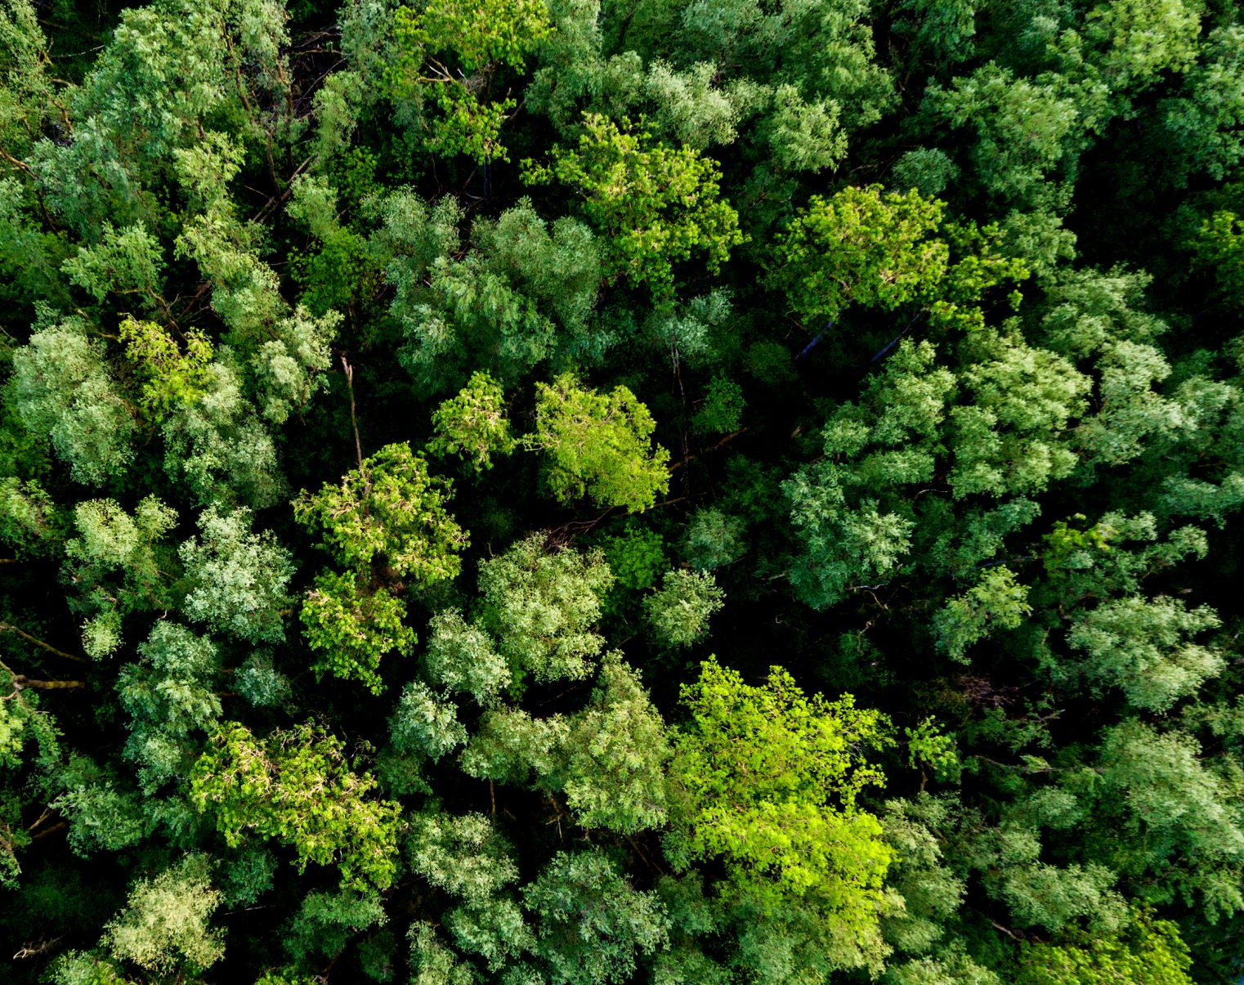
I see trees of green
Louis Armstrong

Slide 2
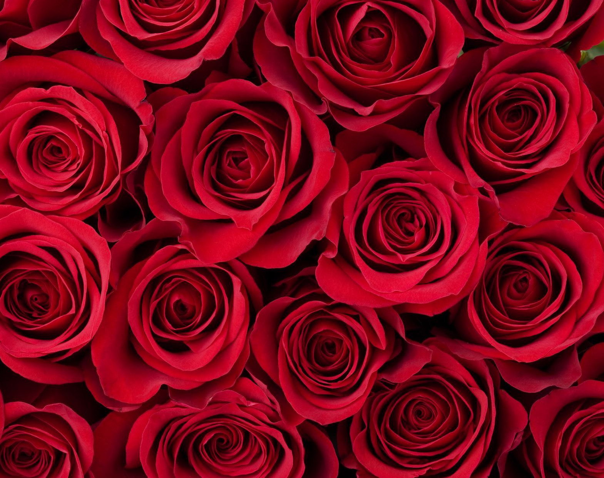
Red roses too

Slide 3
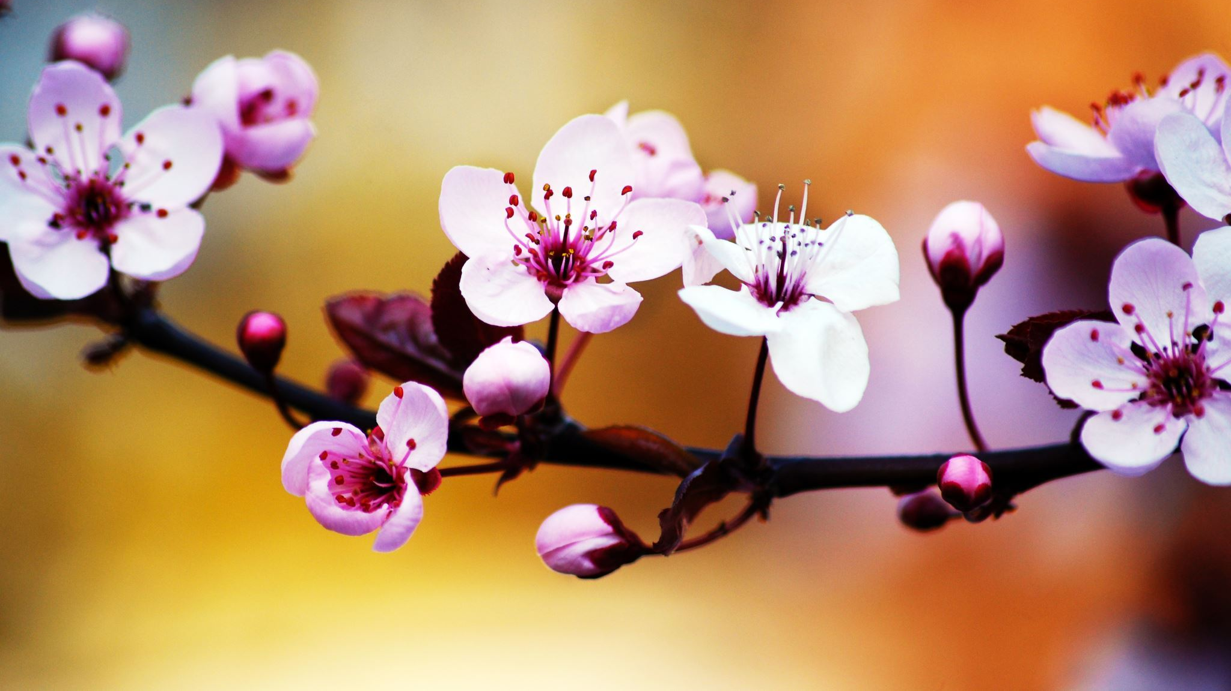
I see them bloom

Slide 4
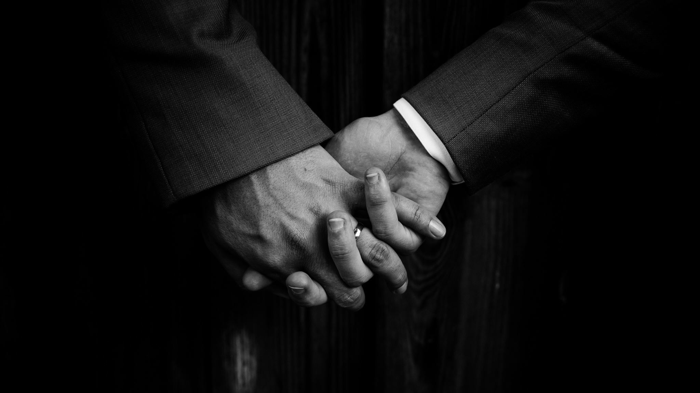
For me and you

Slide 5

And I think to myself

Slide 6
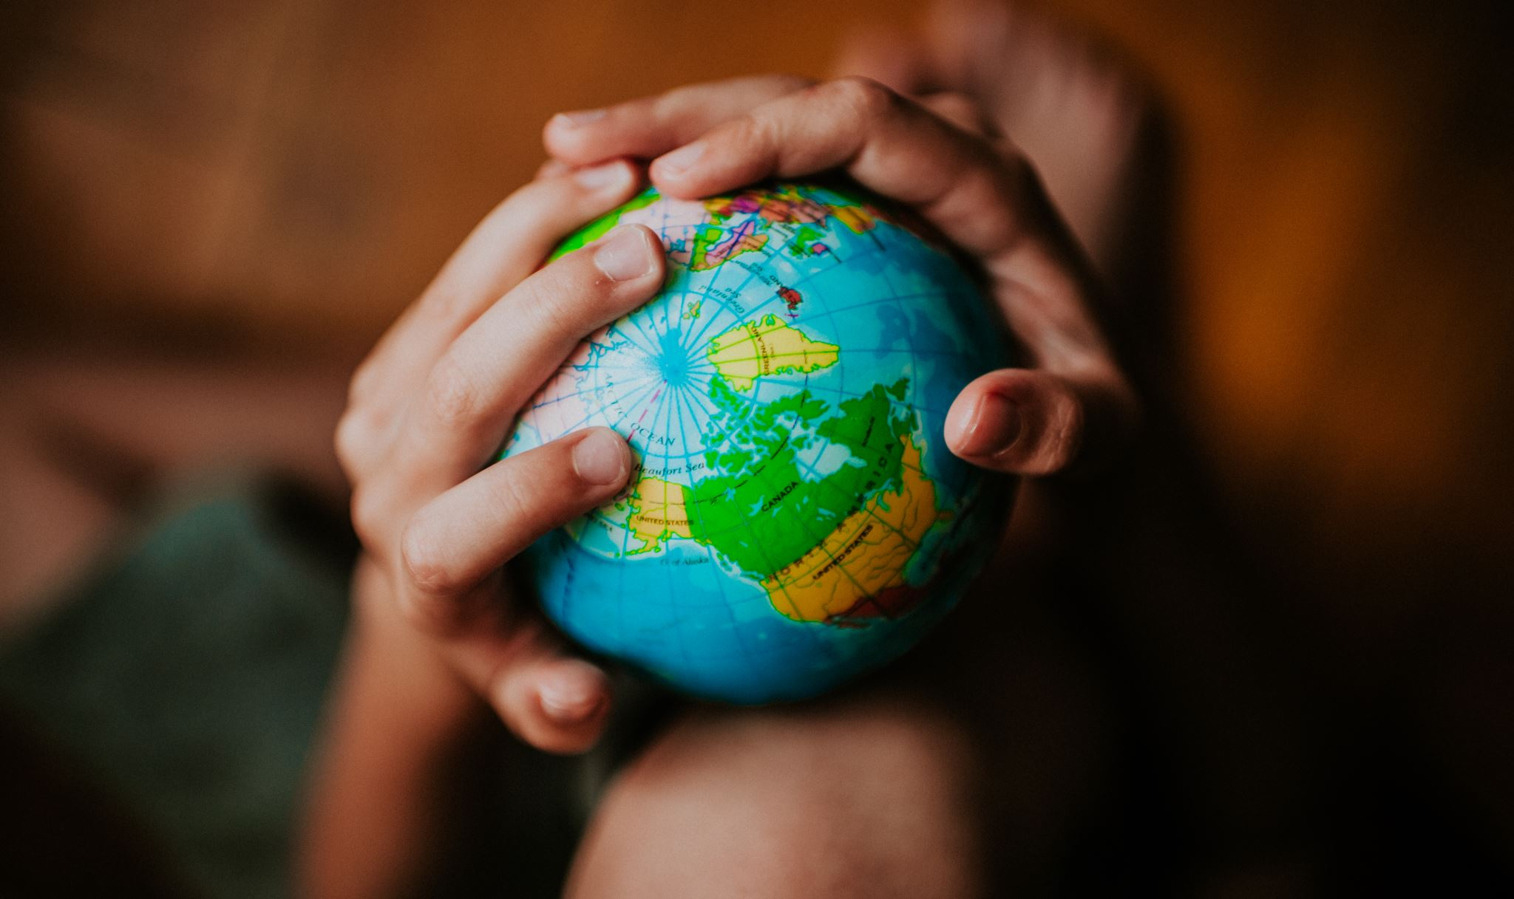
What a wonderful world

